Slide 1



Power BI Integration with CDS on Power Portal
Anjali Tambe
Software Engineer, Larsen & Toubro Infotech
KL Microsoft BizApps & Power Platform User Group - June 2020 Meet-up

Slide 2


About me
Navision Consultant
Power Platform Enthusiast
Let’s Connect!
https://www.linkedin.com/in/anjalitambe/

Slide 3
Agenda
1. Power BI CDS establish connection
2. Manage Roles and Authentication
3. Embed a Power BI Report in Portal

Slide 4
Prerequisites
Power BI Desktop installed. Signed in.
Workspace in Power BI Web
Environment with CDS
License: Power BI Pro, Dynamics 365 Customer Engagement Plan
Admin Center settings: Portal, AAD, Power BI

Slide 5
Power BI CDS establish connection
On Power BI Desktop
Get Data → Power Platform → Common Data Service
Select required Entities and Load

Slide 6
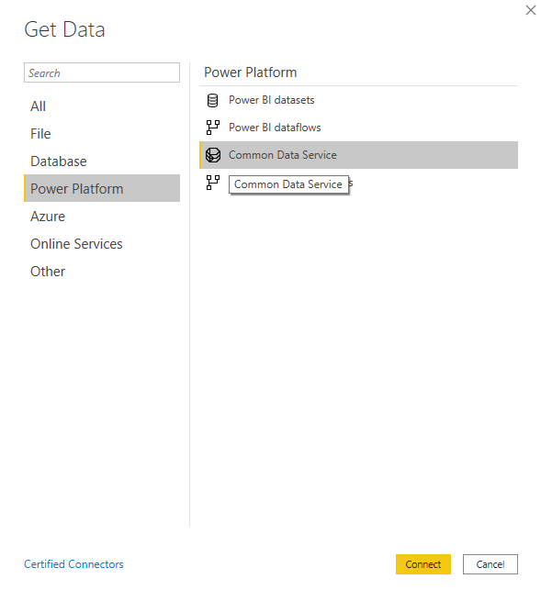
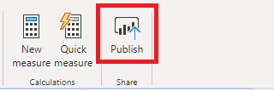
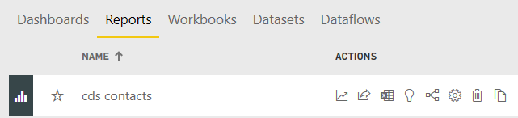
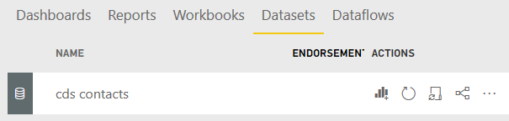
Get Data in Power BI Desktop and Publish to Power BI Web

Slide 7
Configurations & Preparatory Steps
Power Apps Portal Admin Center
Enable Power BI visualization
Enable Embed Power BI Web Service
Take note of Application ID & create a Security Group in AAD

Slide 8
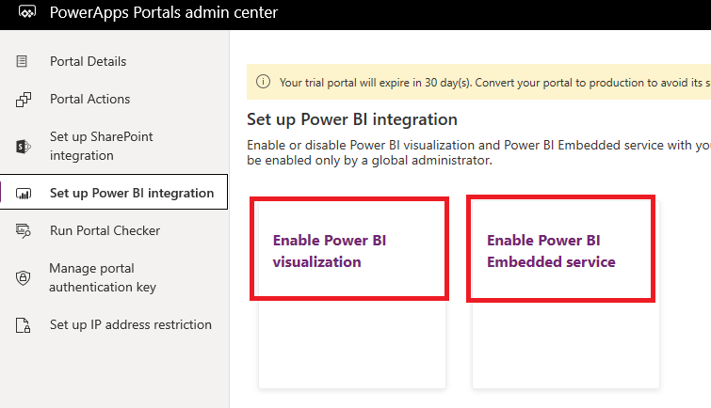
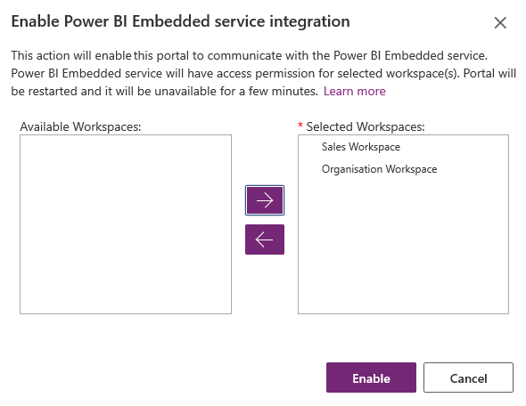
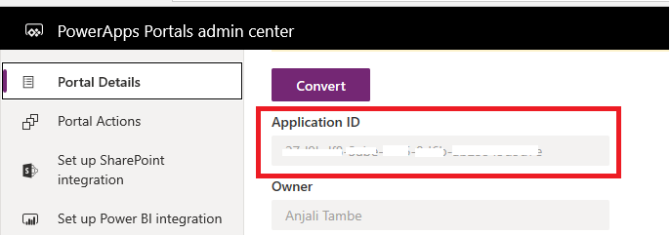
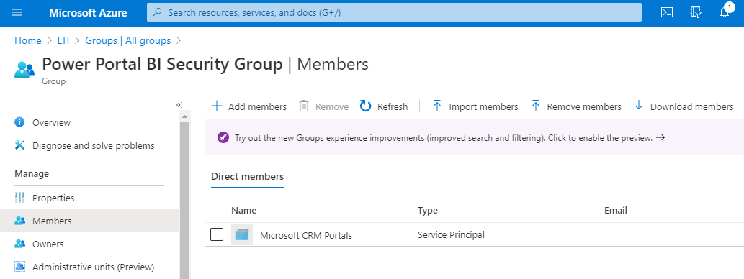
Enable Power BI set up and create a security group in Azure AD with Power BI Application ID

Slide 9
Configurations & Preparatory Steps
Power BI Admin Center
Under Tenant Setting look for:
Developer Setting – enter the security group created in AAD
Publish to Web

Slide 10
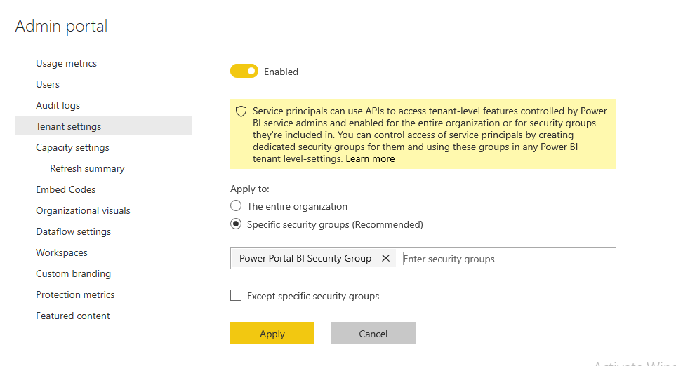
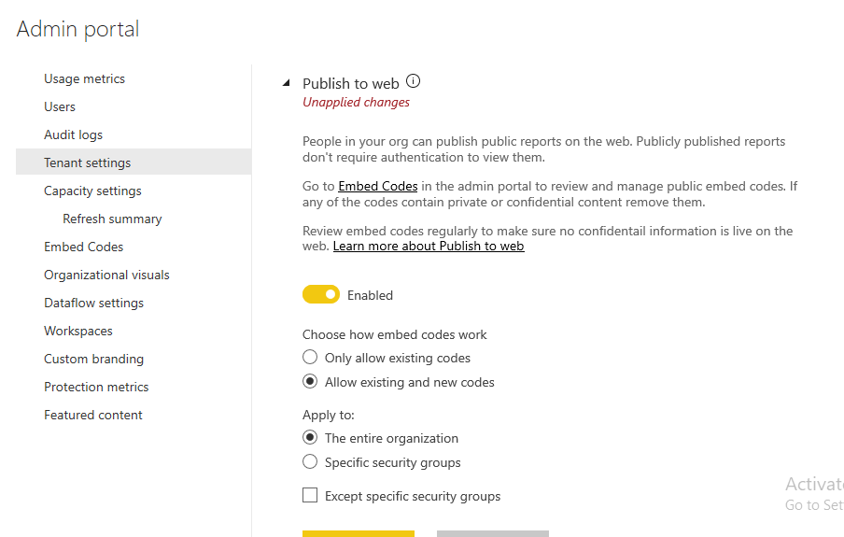
Developer settings
Power BI – Admin Portal Settings
Embedded Codes

Slide 11
Manage Roles and Authentication
Implement RLS in Power BI
Make Web Roles in Power Portal
Both the names should be identical

Slide 12
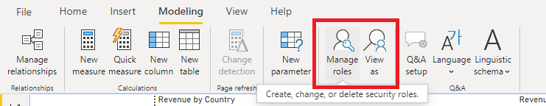
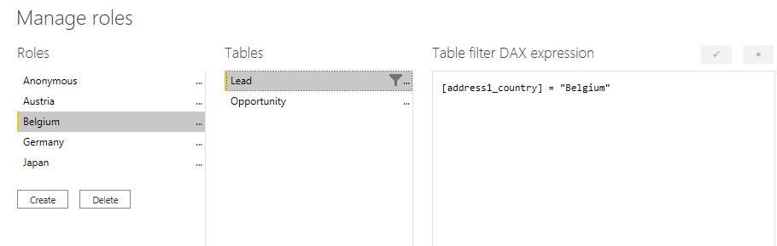
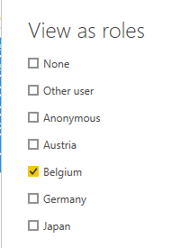
Row Level Security (RLS) in Power BI Desktop

Slide 13
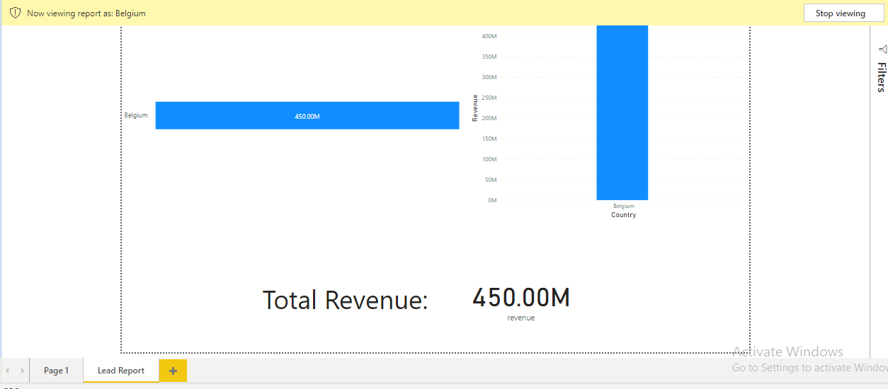
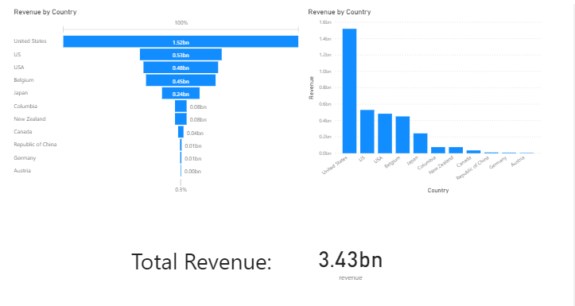
Viewing in “Belgium” role

Slide 14
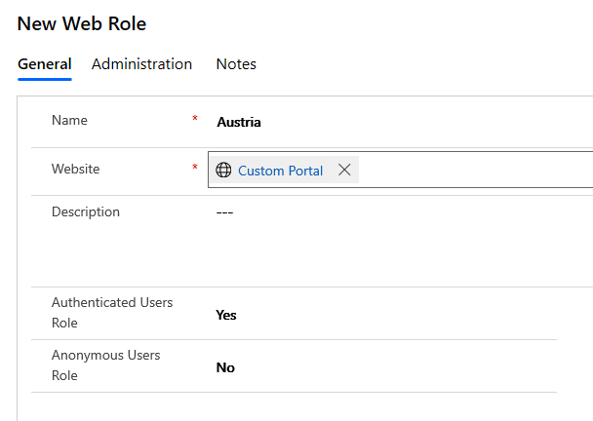
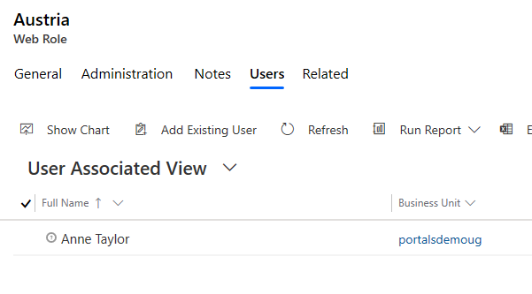
Make a Web Role in Power Portals and add users

Slide 15
Embed a Power BI Report in Portal
1. <iframe>
2. {% liquid tag %}
a. anonymous
b. aad
c. powerbiembedded (RLS – Web Roles)

Slide 16
Code Snippets -
AAD Authentication
{% powerbi authentication_type:"aad" path:"https://app.powerbi.com/groups/0000-000-000-0000-/reports/0000-000-000-0000/ReportSectiond100" %}
Anonymous Authentication
{% powerbi authentication_type:"anonymous" path:"https://app.powerbi.com/reportEmbed?reportId=0000-000-000-0000-/reports/0000-000-000-0000f&amp;autoAuth=true&amp;ctid=0000-000-000-0000-/reports/0000-000-000-0000&amp;config=AaAaaaaaAAAAa%3D%3D"%}
Embedded iframe component
<iframe src="https://app.powerbi.com/reportEmbed?reportId=0000-000-000-0000&amp;autoAuth=true&amp;ctid=0000-000-000-000&amp;config=AaAaaaaaAAAAa%3D%3D"frameborder="0" style="width: 710px; height: 541px; display: block;"></iframe>

Slide 17
Code Snippets -
Powerbi Embedded
Supplying Web Roles of Portal to powerbiembedded tag
{% assign webroles = user.roles | join: ", "%}
<h2>Roles : {{webroles}} </h2>
{% powerbi authentication_type:"powerbiembedded" path:"https://app.powerbi.com/groups/0000-000-000-000/reports/0000-000-000-000/ReportSectiond1" roles:webroles%}

Slide 18
When to use what?
1. Power BI embedded - securely share the Power BI dashboards or reports to external users without Power BI license or AAD authentication setup.
2. Anonymous and iframe - publish to web Power BI reports
3. AAD - share secure Power BI reports or dashboards to Power BI Azure Active Directory authenticated users.

Slide 19
References
https://docs.microsoft.com/en-us/powerapps/maker/portals/liquid/portals-entity-tags
https://docs.microsoft.com/en-us/powerapps/maker/portals/admin/set-up-power-bi-integration
https://docs.microsoft.com/en-us/powerapps/maker/portals/compose-page#add-power-bi
Microsoft Power BI: Integrate interactive Power BI reports in your portal - THR2033 - https://www.youtube.com/watch?v=EjCoM06hHJA

Slide 20
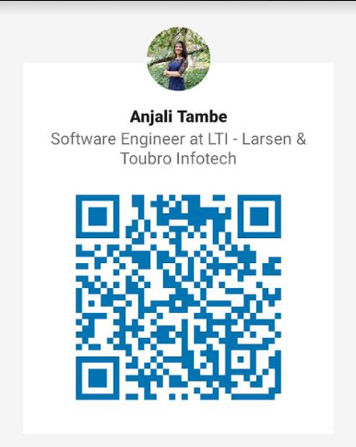
QnA
Let’s Connect on LinkedIn!
https://www.linkedin.com/in/anjalitambe/
Mail – anjalitambe14@gmail.com

